Slide 1
Promptable Pathology
Zero-Shot Medical Image Segmentation with Foundation Models
Infrastructure: TAMU HPRC Grace | Experiments: 50+ SLURM Jobs

Slide 2
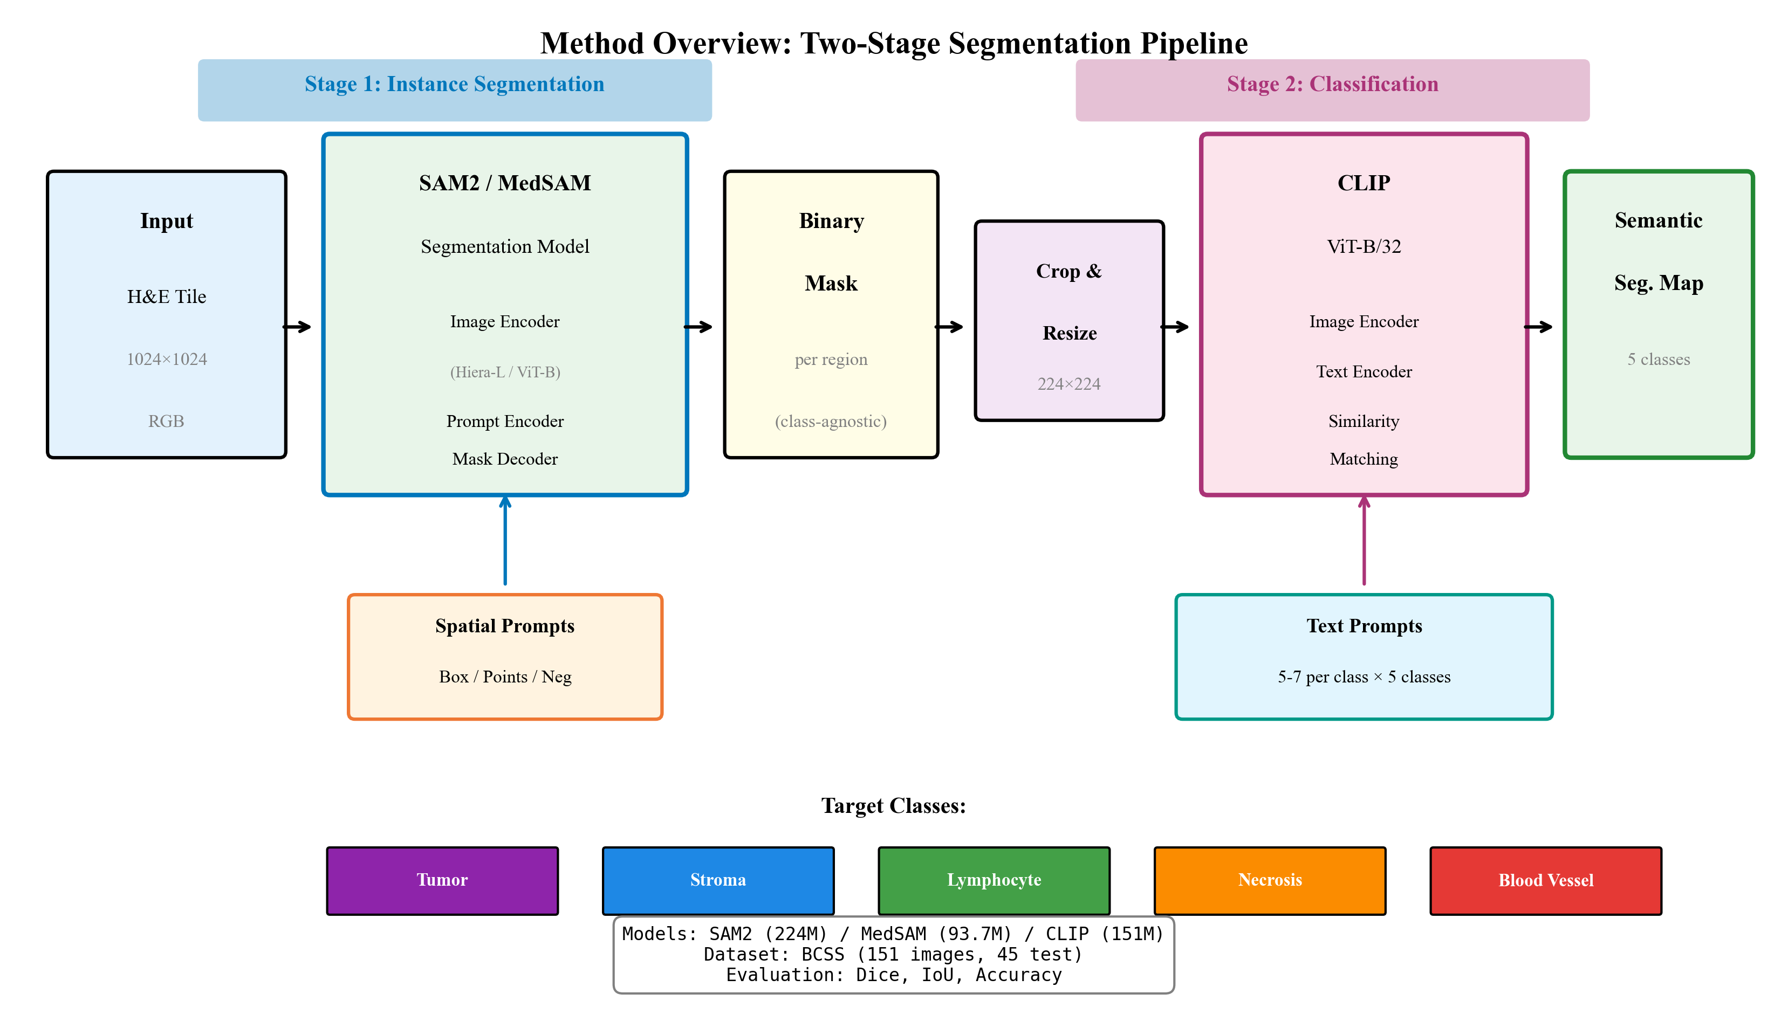
Interactive Segmentation Pipeline

Slide 3
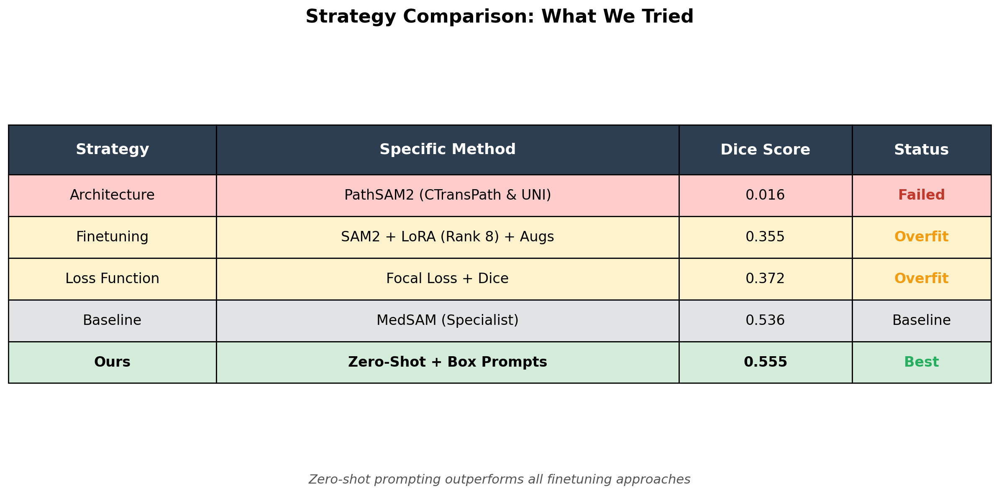
Exhaustive Experimentation
Other Failed Strategies: • Ensembling (CLIP+PLIP) • Multi-scale inputs • Stain Augmentation • Iterative Refinement • Test-Time Training
Notes:
We tested UNI, PLIP, and Ensembles. All underperformed simple Prompt Engineering.

Slide 4
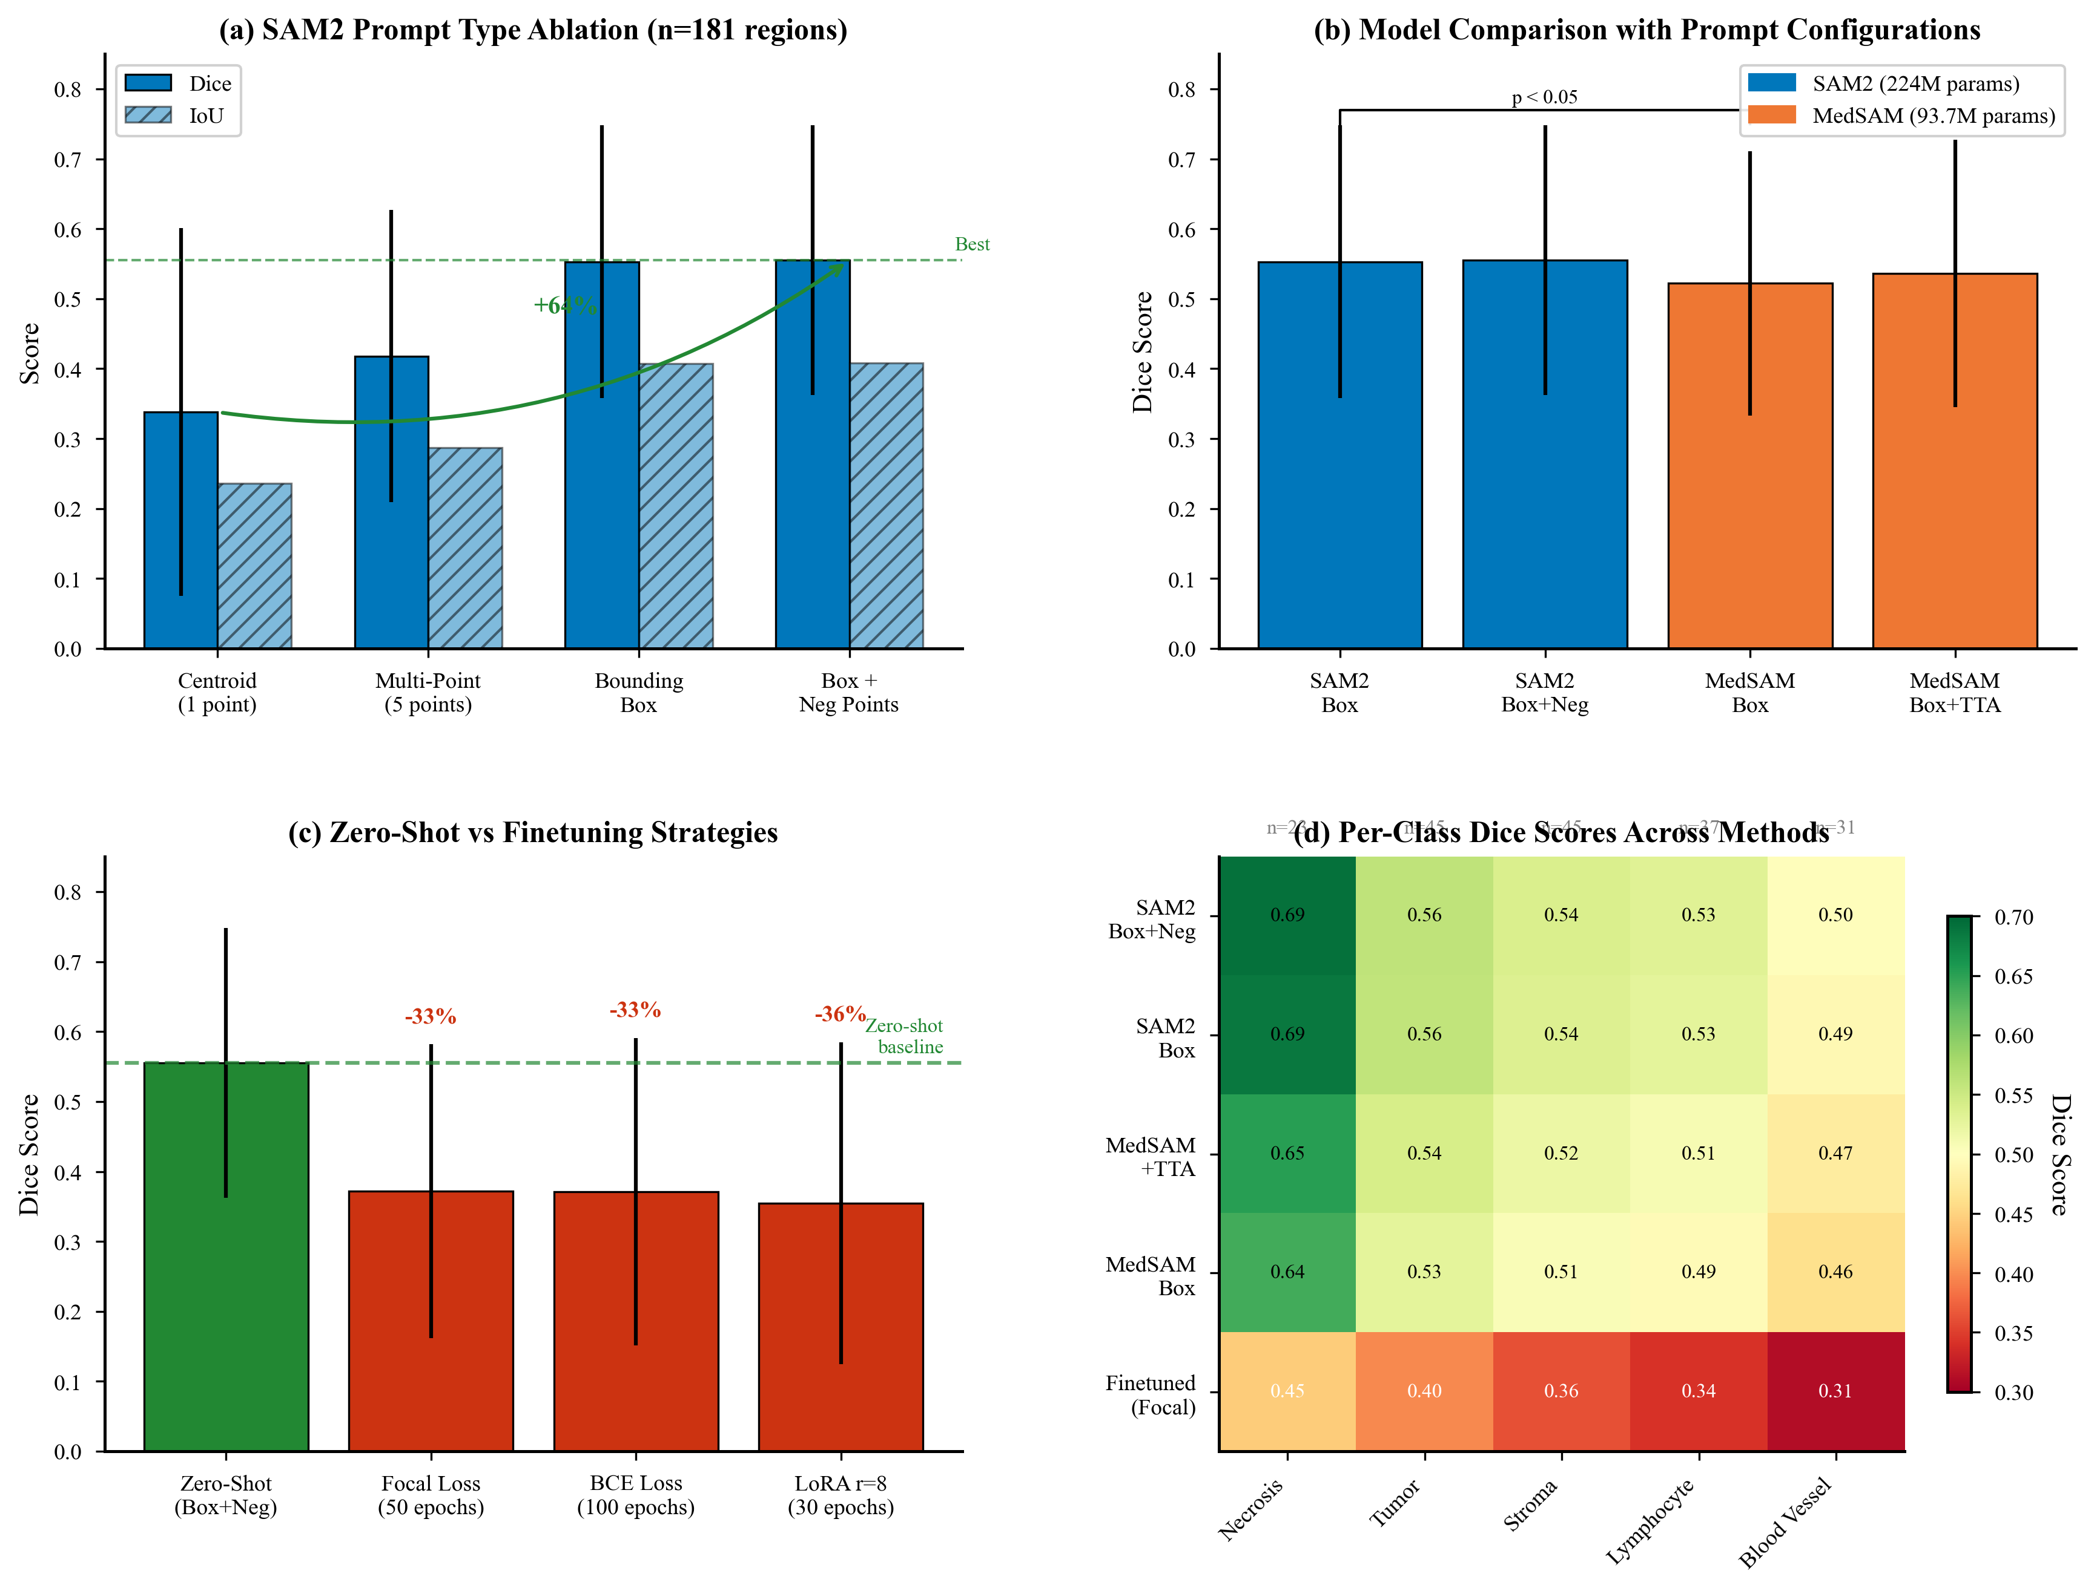
Prompting Beats Weights

Slide 5
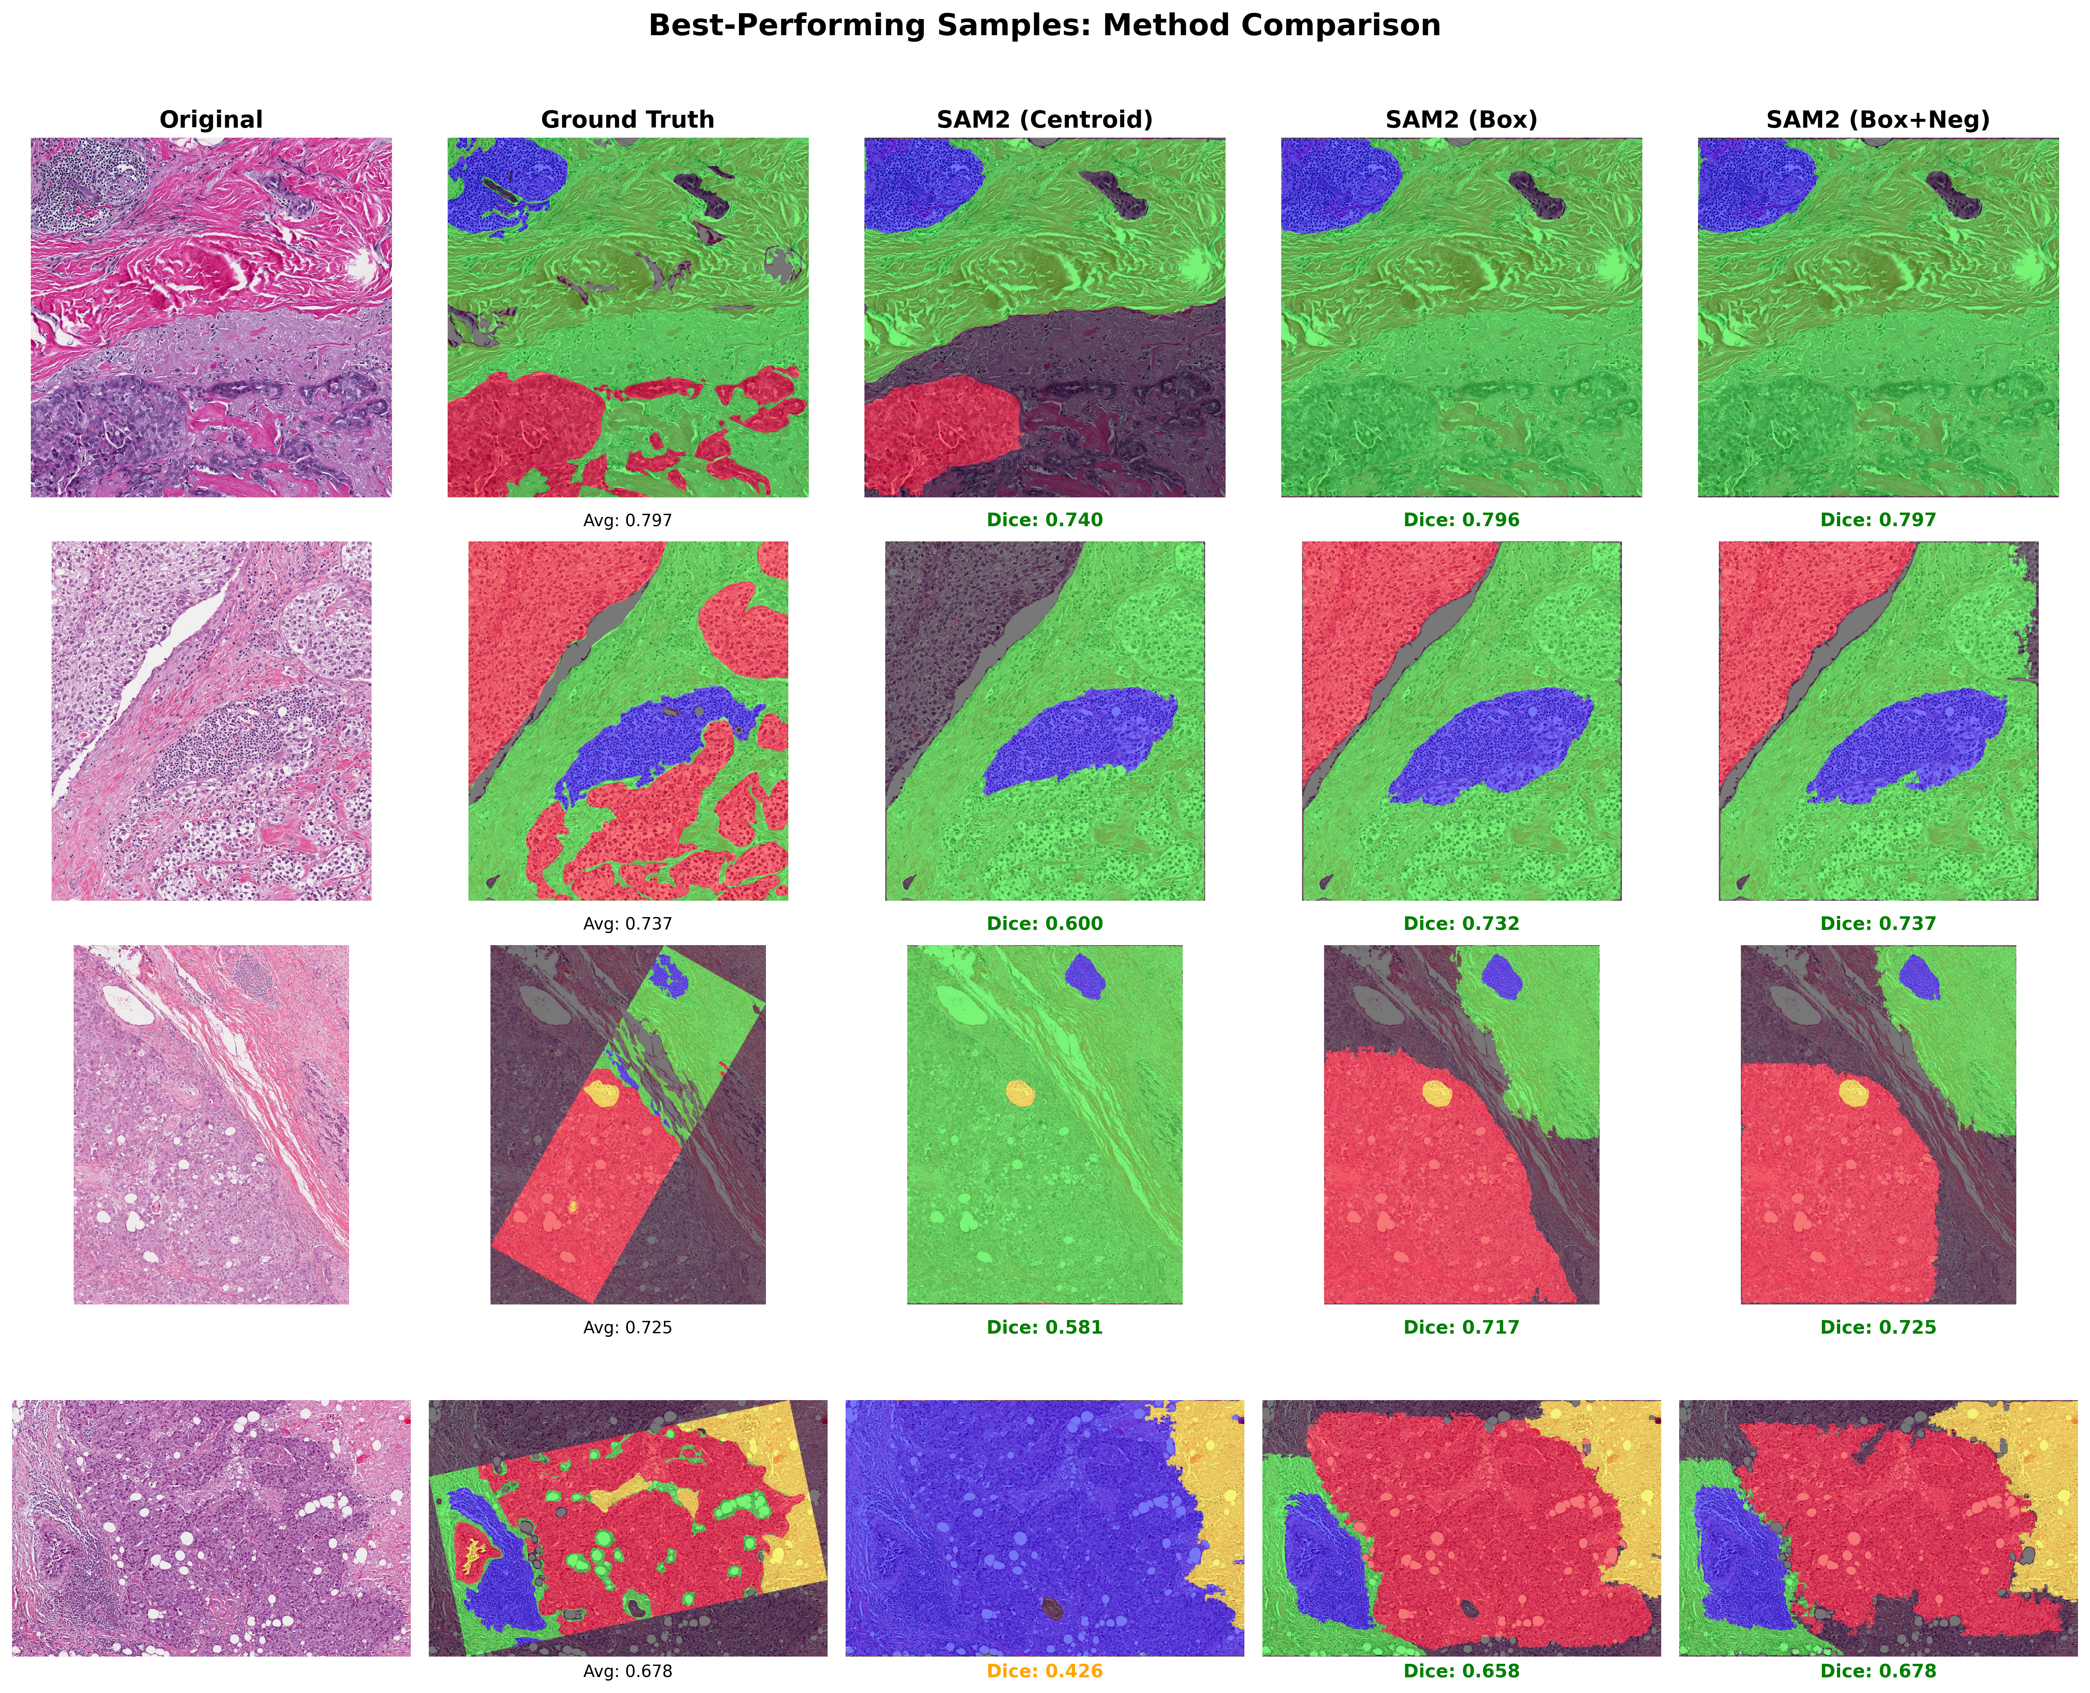
Visual Evidence

Slide 6
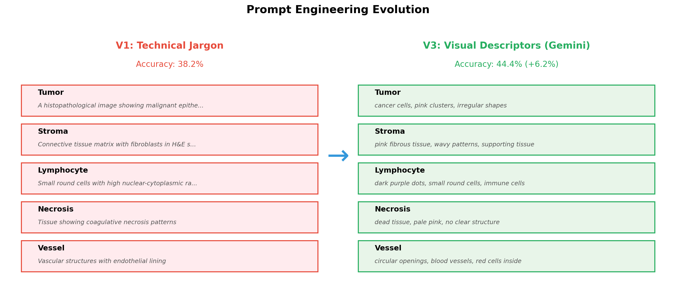
Optimizing Language for Vision

Slide 7
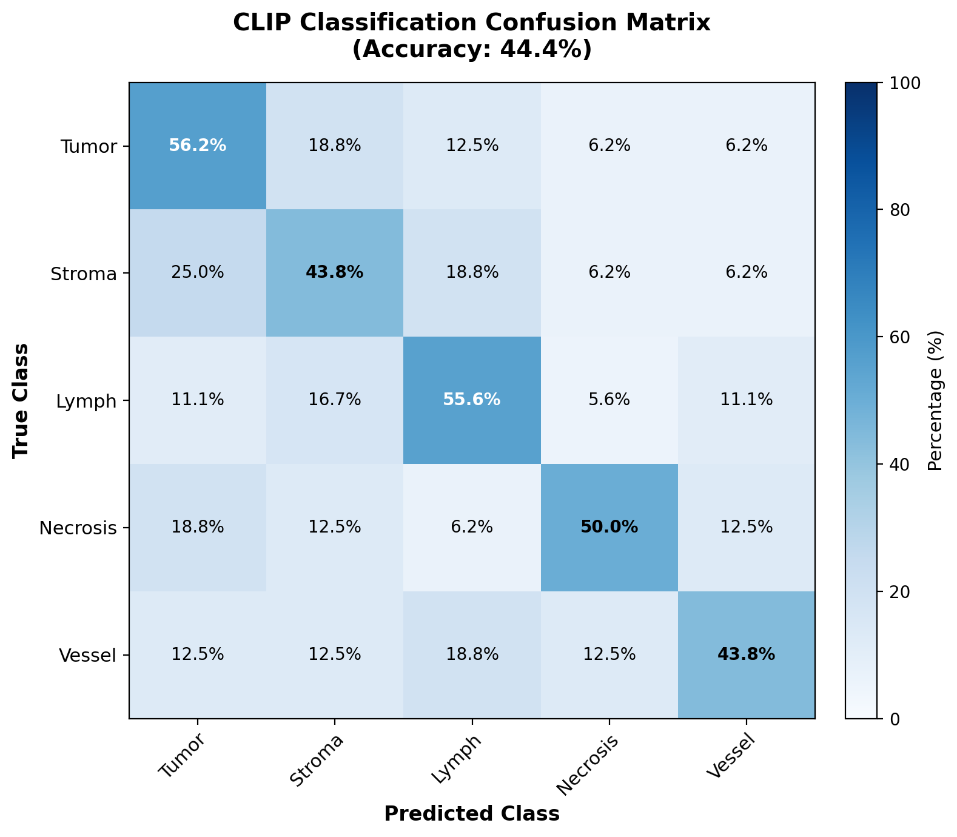
Classification Results
• Ours (44.4%) beats PLIP/Medical-CLIP (26.9%)

Slide 8
Key Takeaways
✓
Prompts > Weights
Zero-shot prompting outperforms extensive finetuning
✓
Zero-Shot SOTA
Best Dice: 0.555 without any training
✓
Foundation Models Work
SAM2 + CLIP generalize to pathology with proper prompts
✓
Simple is Better
Box prompts + visual descriptors beat complex architectures

